Slide 1
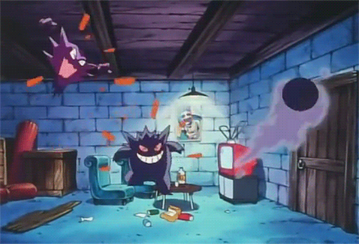
Ha Ha Ha~
What can we do?

Slide 2
Let’s sing!

Slide 3
P32~P33

Slide 4
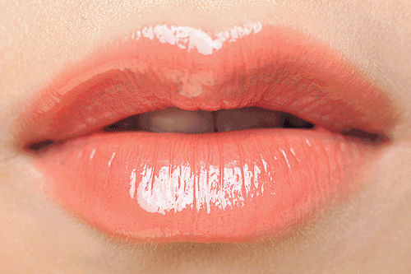
ip
l

Slide 5
s
ip

Slide 6
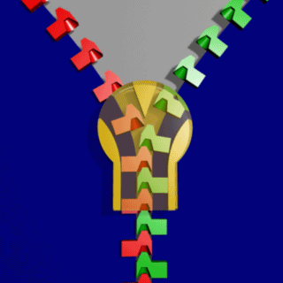
z
ip

Slide 7
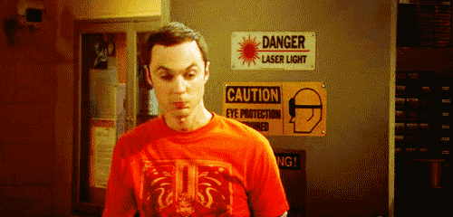
Zip your lip.

Slide 8
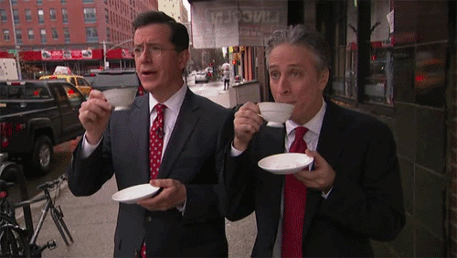
Sip your tea.

Slide 9
Zip your lip and sip your tea.

Slide 10
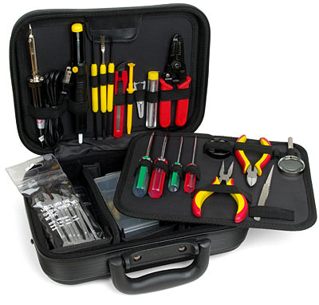
k
it

Slide 11
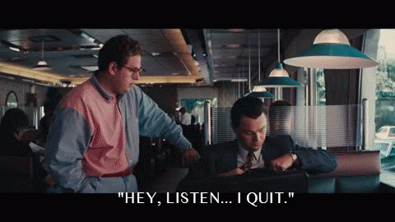
qu
it

Slide 12
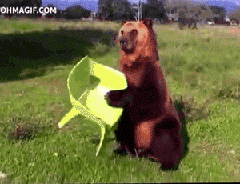
s
it

Slide 13
Don’t quit.

Slide 14
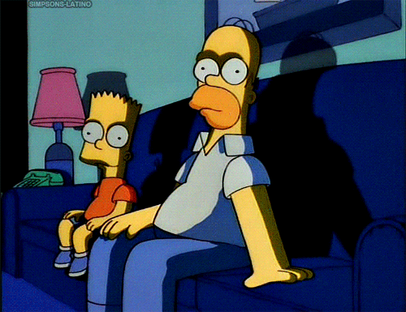
Sit for a bit.

Slide 15
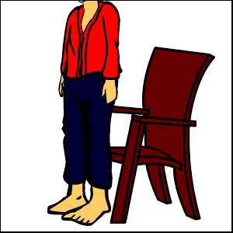
You can sit by the kit.

Slide 16
am
en
it
an
ell
ip

Slide 18
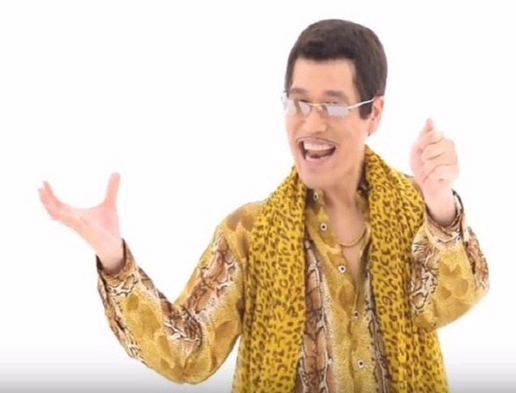

Slide 19
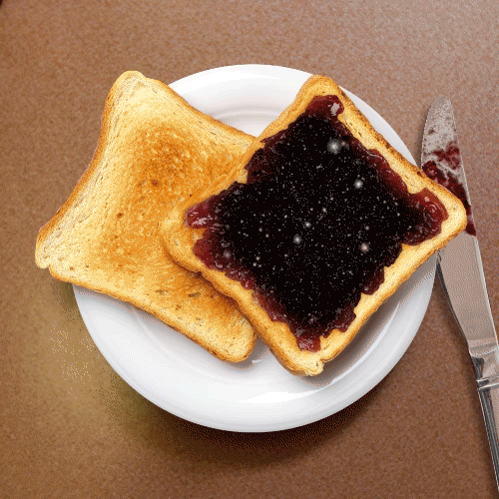

Slide 21
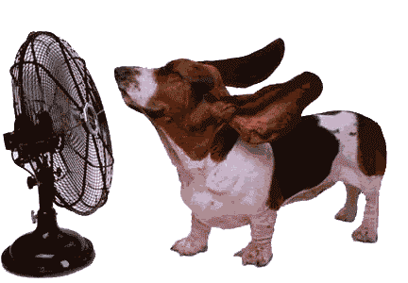

Slide 24
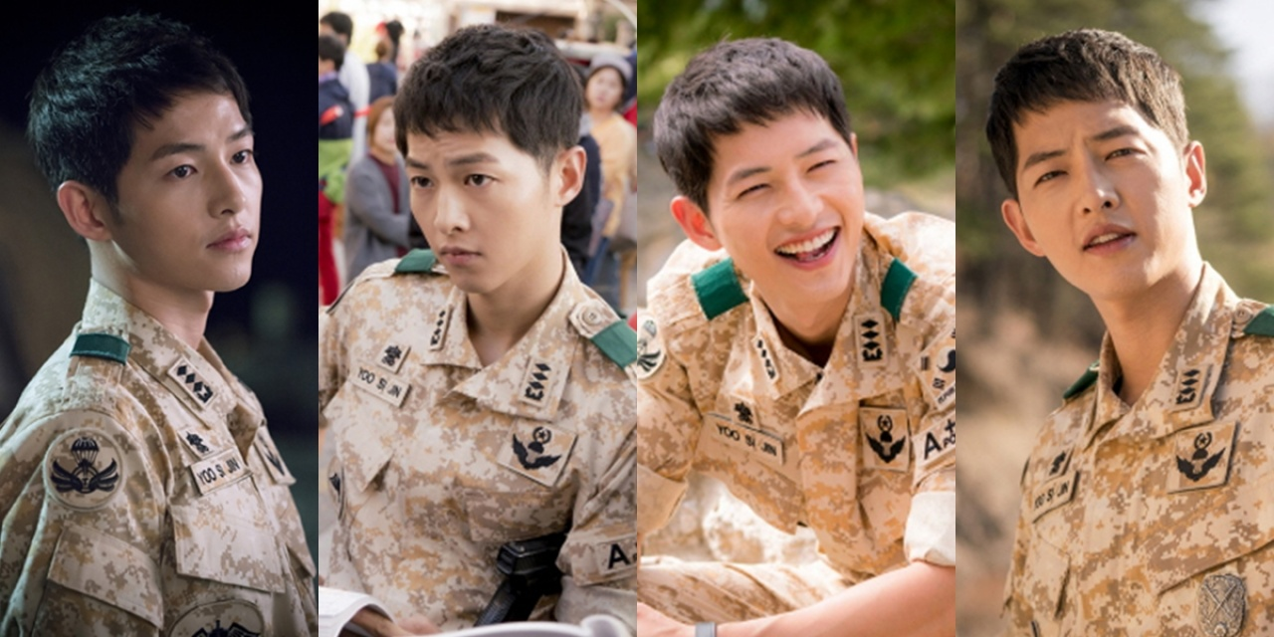

Slide 25
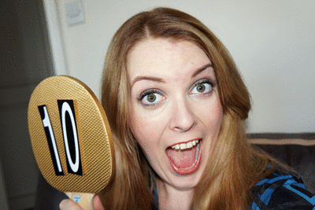

Slide 27
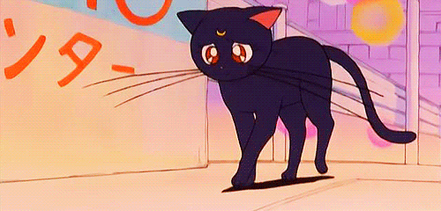

Slide 28
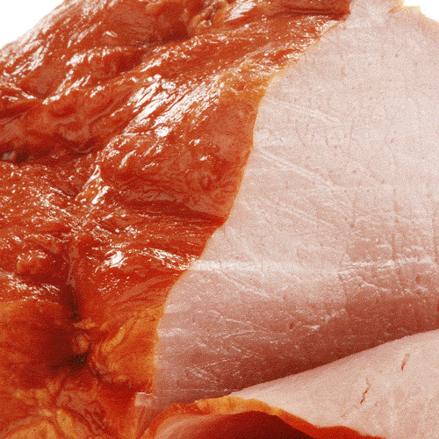

Slide 29
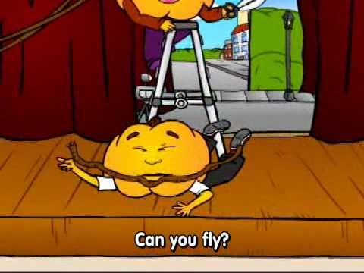
Pumpkin Cartoon

